Slide 1
FRESH PLATES
Presented by
Mihika Sanghvi & Jasna Budhathoki

Slide 2

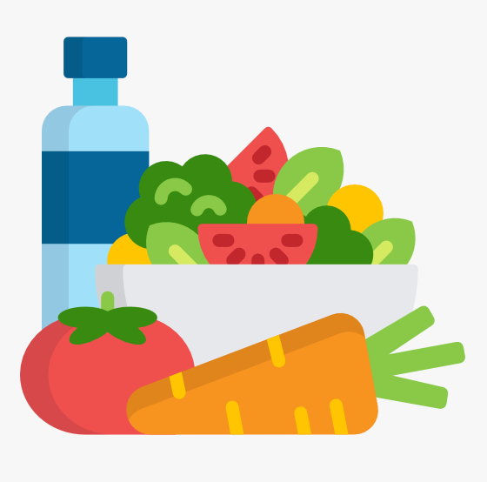
Mission
“To make healthy home cooking effortless by connecting personalized recipes with real-time Amazon Fresh shopping.”

Slide 3


Fresh Plates Features
PERSONALIZED RECIPES:
GENERATES CUSTOM RECIPES BASED ON USER INGREDIENTS, DIET, AND CALORIE GOALS.
SMART CONSTRAINTS:
UNDERSTANDS HARD AND SOFT DIETARY PREFERENCES.
AMAZON FRESH INTEGRATION:
MAPS INGREDIENTS TO REAL-TIME PRODUCTS WITH A 1-CLICK SHOPPABLE CART.
NUTRITION INSIGHTS:
PROVIDES CALORIE AND MACRO BREAKDOWN FOR EVERY RECIPE.
PANTRY AWARENES:
SUGGESTS MEALS USING INGREDIENTS USERS ALREADY HAVE.
Notes:
Personalized Recipes:
Generates custom recipes based on user ingredients, diet, and calorie goals.
Smart Constraints:
Understands hard (must-have) and soft (nice-to-have) dietary preferences.
Amazon Fresh Integration:
Maps ingredients to real-time products with a 1-click shoppable cart.
Nutrition Insights:
Provides calorie and macro breakdown for every recipe.
Pantry Awarenes:
Suggests meals using ingredients users already have.

Slide 4
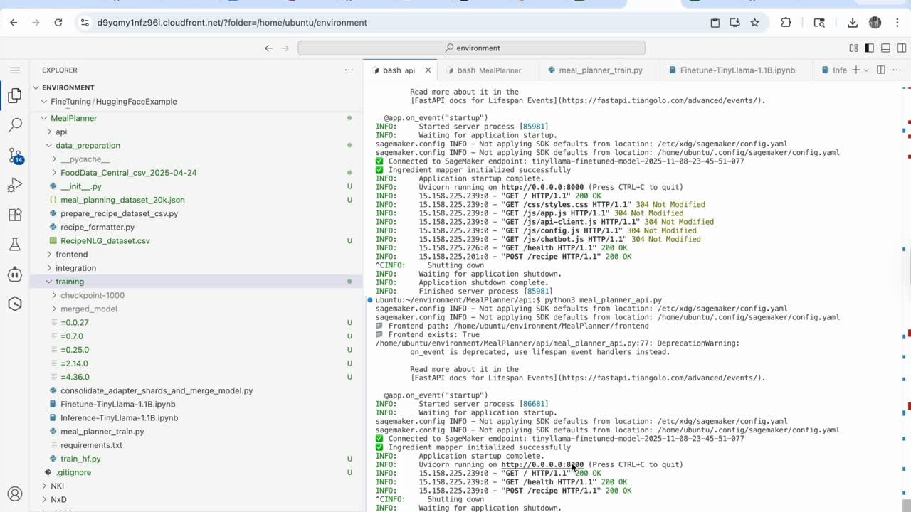
Demo
Notes:
Personalized Recipes:
Generates custom recipes based on user ingredients, diet, and calorie goals.
Smart Constraints:
Understands hard (must-have) and soft (nice-to-have) dietary preferences.
Amazon Fresh Integration:
Maps ingredients to real-time products with a 1-click shoppable cart.
Nutrition Insights:
Provides calorie and macro breakdown for every recipe.
Pantry Awarenes:
Suggests meals using ingredients users already have.

Slide 5
Tech Stack
MODEL & TRAINING
Model: TinyLlama-1.1B-Chat (LoRA fine-tuned)
Libraries: Hugging Face Transformers, PEFT, Optimum Neuron
Dataset: 20 K structured meal-planning dialogues (system, user, assistant)
Training Platform: AWS SageMaker (Trainium II – ml.trn1.2xlarge)
LoRA Config: r = 16 | α = 32 | dropout = 0.05
Artifacts: Model checkpoints → Merged adapter → S3 → SageMaker Endpoint
We trained our TinyLlama-1.1B-Chat model on an AWS SageMaker Training Job using a Trainium instance
INFERENCE & DEPLOYMENT
ENDPOINT: TINYLLAMA-FINETUNED-MODEL-2025-11-08-23-45-51-077
SERVING STACK: AWS SAGEMAKER ENDPOINT + BOTO3 + SAGEMAKER SDK
FORMAT: JSON PAYLOAD → PREDICTOR OBJECT → MODEL OUTPUT (RECIPE + INGREDIENTS + CALORIES)
Notes:
Personalized Recipes:
Generates custom recipes based on user ingredients, diet, and calorie goals.
Smart Constraints:
Understands hard (must-have) and soft (nice-to-have) dietary preferences.
Amazon Fresh Integration:
Maps ingredients to real-time products with a 1-click shoppable cart.
Nutrition Insights:
Provides calorie and macro breakdown for every recipe.
Pantry Awarenes:
Suggests meals using ingredients users already have.

Slide 6
Tech Stack
BACKEND
Framework: FastAPI (Python 3.10)
Functions: /plan, /recipe, /ingredients/shop, /health
Integration: IngredientMapper → Amazon Fresh search URLs
Hosting: Uvicorn server + CORS-enabled API
FRONTEND
STACK: HTML | CSS | JAVASCRIPT
UI: CHAT-STYLE INTERFACE WITH EXAMPLE PROMPTS & LOADING OVERLAY
FILES: INDEX.HTML, CSS/STYLES.CSS, JS/APP.JS, JS/API-CLIENT.JS
INFRASTRUCTURE
STORAGE: AMAZON S3 (FOR DATASET & MODEL ARTIFACTS)
COMPUTE: AWS TRAINIUM II (TRAINING) | SAGEMAKER INFERENCE INSTANCE (HOSTING)
Notes:
Personalized Recipes:
Generates custom recipes based on user ingredients, diet, and calorie goals.
Smart Constraints:
Understands hard (must-have) and soft (nice-to-have) dietary preferences.
Amazon Fresh Integration:
Maps ingredients to real-time products with a 1-click shoppable cart.
Nutrition Insights:
Provides calorie and macro breakdown for every recipe.
Pantry Awarenes:
Suggests meals using ingredients users already have.

